Slide 1

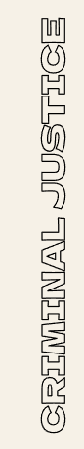
CRIMINAL JUSTICE USING AI
By: Riddhima Jain

Slide 2
CONTENTS OF THIS TEMPLATE
Set up the problem. What is COMPAS? What are the issues with the dataset? What are the biases it's perpetuating?
Why would machine learning be introduced to this dataset? What are we trying to predict?
Talk about the models we used. Did we reduce bias? Why/why not?
Confusion Matrices. and Fairness (false positive rates). Talk about the features, proxies, and the feature importance.
What did y'all do to reduce bias and increase fairness in the end?
Conclusions from the project. How can we increase fairness going forward and why is this important (again)?

Slide 3
TABLE OF CONTENTS
01
02
03
Setting Up The Problem
Machine Learning
Types of ML Models
04
05
06
CMS & Fairness
Bias & Fairness
Conclusion

Slide 4


Setting Up The Problem
PURPOSE: To find racial bias in the AI models used in the criminal justice system and explore the question… “Can AI models be more just than human judgment and improve the world?”
COMPAS:
Correctional Offender Management Profiling for Alternative Sanctions
Algorithm assessment tool to predict if a person is likely to commit another crime before the trial
Used to decide if one is bailed in many US states… with the assumption that machine learning models should be less biased than humans

Slide 5


ISSUES IN DATASET
DATASET
From Florida’s public records
Having race as a variable in the dataset is problematic…the algorithm uses the race as a factor when deciding if one should be bailed
There’s also significant disproportion in sample sizes of each races
Native Americans and Asians were underrepresented - unavoidable bias
So, we made many models to see if the algorithm is ‘fair’ when it comes to race

Slide 6
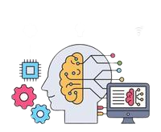
Machine Learning
Machine Learning has been introduced to this data set due to the fact that computers are more logical than humans and have less chance of making an error and less of a chance of having bias. As computers use a large amount of data to analyze the inputs, the outputs that are produced are more accurate than the outputs produced by humans.
The thing we are trying to predict in this project is if someone will recidivate(commit another crime after being released from prison).

Slide 7

EVALUATING ACCURACY
In order to gauge the success of our model, we looked specifically at prediction accuracy. This means our rate of correctness in predicting whether or not an individual would recidivate (relapse into criminal behavior).
To further visualize this, we compiled our data into confusion matrices, allowing us to see false positives, false negatives, and ultimately calculate our rate of accuracy. These results indicated further ethical questions, such as:
Is our prediction model accurate?
What does our data communicate about fairness?
How can we improve accuracy ratings, such that our
results induct judgment equitably towards all groups?
 | POS | NEG
NEG | TP | FP
POS | FN | TN
Notes:
Our goal was to achieve the highest accuracy (heaviest in areas TP and TN

Slide 8
FEATURE IMPORTANCE
ASSESSING OUR MODEL
THE RESULT…
PROXIES
Our accuracy ratings depicted more than double the false positive rates in recidivation for African Americans comparable to Caucasians. This shows evident biases and statistic disproportion. To combat this, we tried removing data labels such as race, as a corrective measure.
Despite rerunning and excluding these problematic factors in our calculations, we rendered near equal results. We theorized this to be “proxy” data that still exists, and is perpetrated through other defacto indicators, such as economic standing, education level and geographic location.
Notes:
One of our key takeaways is that our model accuracy has a direct impact on people. Inaccuracies result in subsequent loss of time with family, potential job displacement, and other societal factors isolating and stigmatizing those that we are sentencing. These predictions should not be something taken lightly.

Slide 9
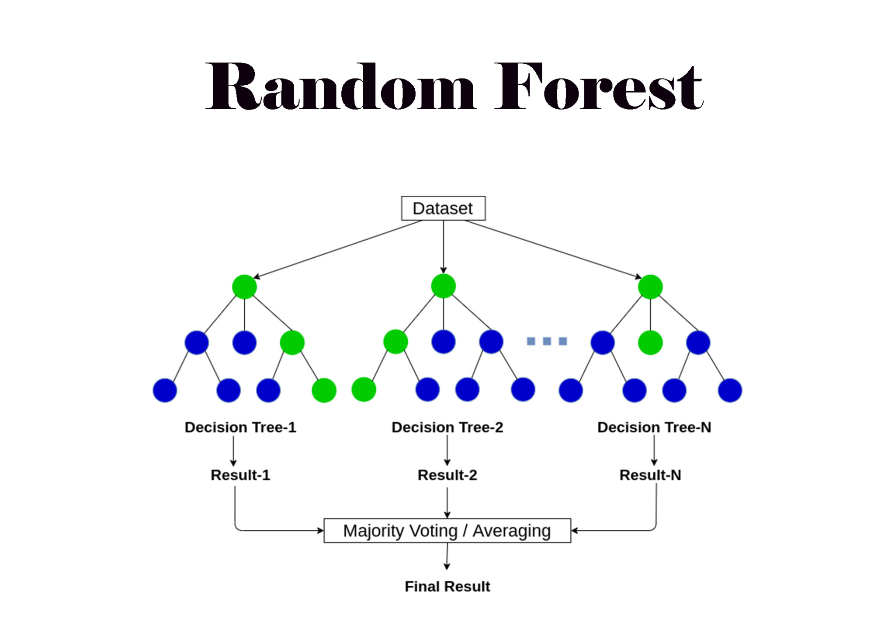
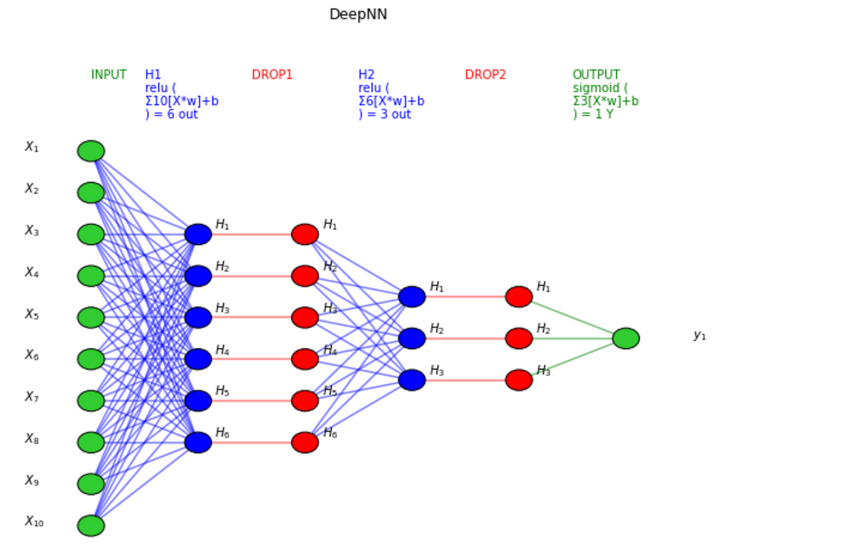
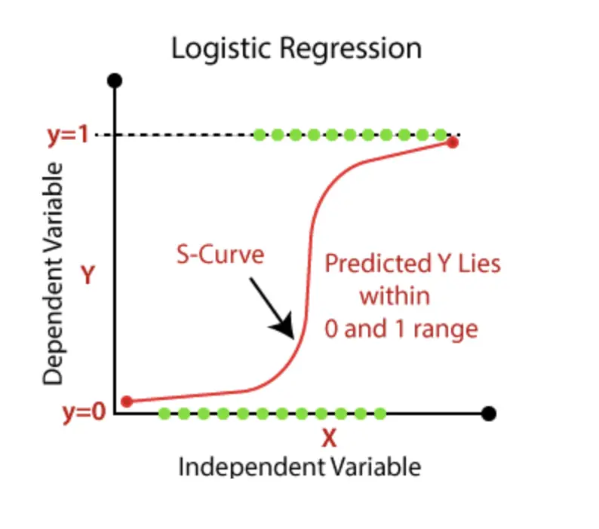
TYPES OF MACHINE LEARNING MODELS
The multiple types of Machine Learning Models that we used:
Logistic Regression
Random Forest
Confusion Matrix (method to assess model accuracy)
Neural Networks (NNs)

Slide 10
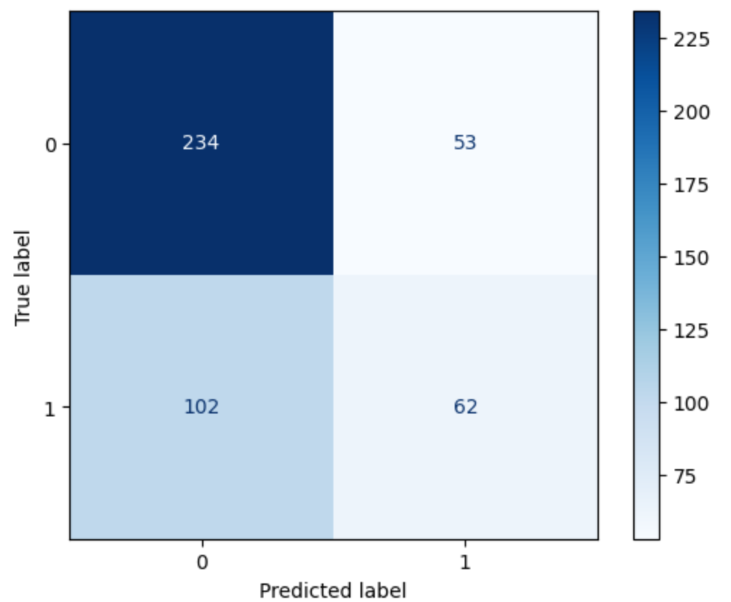
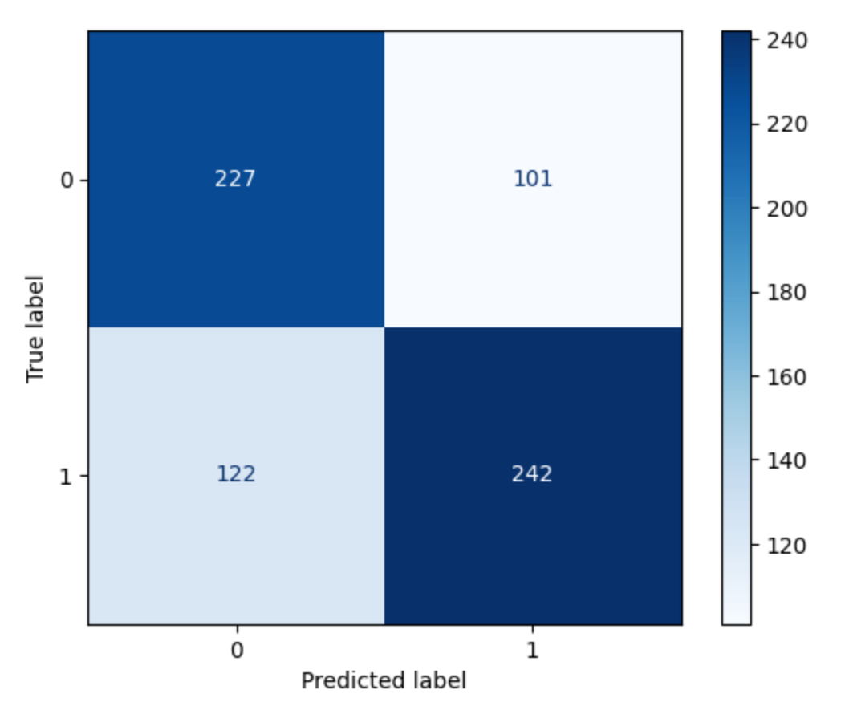
Caucasian African American
Notes:
Confusion Matrix pic. Make sure to say that the false positives are at the top right, where we expected them to recidivate, but in actuality, they did not. African Americans are more at risk.

Slide 11
WHAT DOES EACH MODEL DO?
Logistic Regression: Used to calculate or predict the probability or an event (yes/no) occurring. Supervised learning. Can help predict actions like recidivism.
Random Forest: Combines the output of multiple decision trees to reach a single result. Supervised Learning. (Decision trees classify or regress data by using true or false answers to certain questions.)
Neural Networks: Computational models inspired by the brain that can learn from data, extract patterns, and make predictions or decisions in ML by using interconnected artificial neurons. Supervised Learning.

Slide 12
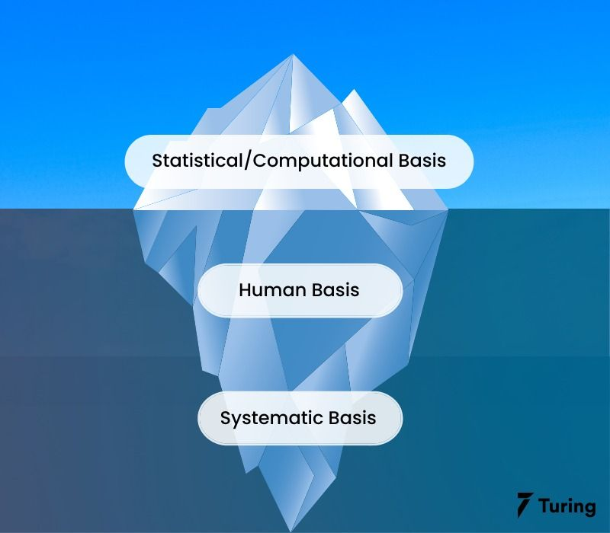

DO THEY REDUCE BIAS?
ML models can play a vital role in reducing the bias within criminal justice system.
Logistic Regression and Neural Networks are capable of building predictive models that assess the likelihood of recidivism.
Confusion Matrices can also provide evaluation metrics to analyze the performance of ML models.
Random Forests can aggregate predictions from multiple decisions trees, which can help mitigate biases.
Notes:
At the same time though, for marginalized communities, the only data we have on them are historically biased, and ML models can only draw on those. This can be improved on the more we are able to draw on more accurate and objective statistics in the future.

Slide 13
What affects a model?
Hidden Layers
Training Data
The number of hidden layers as well as the number of neurons in each are incredibly important. Just changing them slightly can have major impacts on the accuracy of a model
When using a dataset, you have to divide the data into training and testing data. The training data is what the AI uses to create the patterns and pathways it uses to recognize and make decisions when it comes to actual implementation. Having unbiased data is incredibly vital, especially with proxy data and such.
Notes:
When removing clearly problematic data labels, we found there to be little change in the results. We theorized that "proxy" data exists, in the sense that race is perpetuated in other data as some racial groups are more likely than others or are have more convictions in a certain crime.

Slide 14
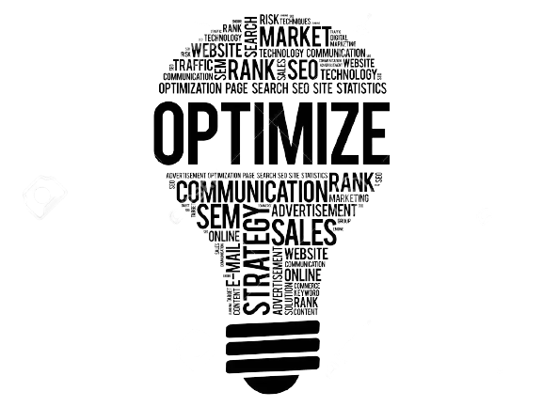
How did we optimise?
Hidden Layers
We just tested a large number of different combinations until we got our highest accuracy
Training Data
In order to remove embedded bias we removed obviously problematic data labels such as race, gender, and such. However, because proxy data became an issue, we tried to negate its effects with additional data that was likely to not have such strong racial effects like the number of prior convictions

Slide 15
What did we do?
MLP Model
Neural Network
Hidden Layers
20 10 5
Variables
Age, Juvenile Offenses, Priors, etc
Notes:
Neural Network
20 10 5
'age', 'age_category', 'juvenile_felony_count', 'juvenile_misdemeanor_count', 'juvenile_other_count',
'prior_convictions', 'current_charge', 'charge_description', 'priors_count.1', 'recidivated_last_two_years'

Slide 16

IN CONCLUSION!

Slide 17

FINAL THOUGHTS
How can we increase fairness moving forward?
Why is this even important?
Our main objective was to figure out how to accurately predict whether criminals will recidivate.
It’s imperative for us to do this without any sort of bias impeding us because people’s lives are at stake whenever authorities make a decision in Criminal Justice.
Objective data is a necessity.
ML models can be expected to improve as time progresses.

Slide 18

Any Questions?

